Slide 1


Slide 2
A.P.SHA MAHAL BOOKING WEBSITE

Slide 3
ABSTRACT
This project is designed to serve the owners of mahal and the users of such mahal .People who are next to marriage, people in charge of holding parties and so on. Through the ability to search for halls according to the users specifications It is displayed on the website including all details about capacity of the hall. Services provided (charges) prices, location of the hall, picture of the hall, the possibility of reserving a hall electronically and other services or details.

Slide 4
ABSTRACT
If the hall specifications are appropriate ,user can move the registration form where they can view the booking schedule of the hall and the days on which they can reserve it . It includes the features and functions needed to efficiently manage an wedding hall. It includes an administrator account which is used to handle control all the system functionality . The system keeps track of wedding hall status and advanced booking.

Slide 5

HARDWARE SPECIFICATION
HARDWARE SPECIFIICATION
Processor : INTEL CORE i3 / i5
RAM : 2 GB
Hard Disk Drive : 500 GB HDD
Disk Drive : DVD Drive
Monitor : 17” Color Monitor
Keyboard & Mouse : Standard Keyboard
&Mouse

Slide 6
SOFTWARE SPECIFICATION
Operating System : Windows 7 / 10
CODING : PHP & HTML
Back end : MY – SQL
Server : XAMPP TOOL 4.0
Document : MS – Word

Slide 7
EXISTING SYSTEM
There was no official website for A. P. Sha Mahal .
Our website reduces the need for in-person Bookings.
It is not only booking like other website, if your date has been booked before then you will not be able to book that day.
The registered receipt is handwritten and can be printed later through this website

Slide 8
PROPOSED SYSTEM
A local host to upload for the all information
A database server to maintain the all information
An elegant tool to designs form.
This website provides better authentication security to the administration. The tax information is stored in the encrypted format. So one users can’t access the another or administration information. The Administrator controls all the information.
To provide proper information briefly. There is no chance to take mistake.
We don’t have to pay extra and we are using less amount of time only.
We can accurately obtain the certificates we need ourselves and it is very secure.
Flexibility of transactions can be completed in time.

Slide 9
MODULES
1. REGISTRATION RULES
Terms of services
2. BOOKING
Availability check , Booking form
3. ABOUT US
Locations and infrastructures
4. CONTACT US …
Address and location map
5.ADMIN MODULE
Booking details, Confirmation
and Cancellations

Slide 10
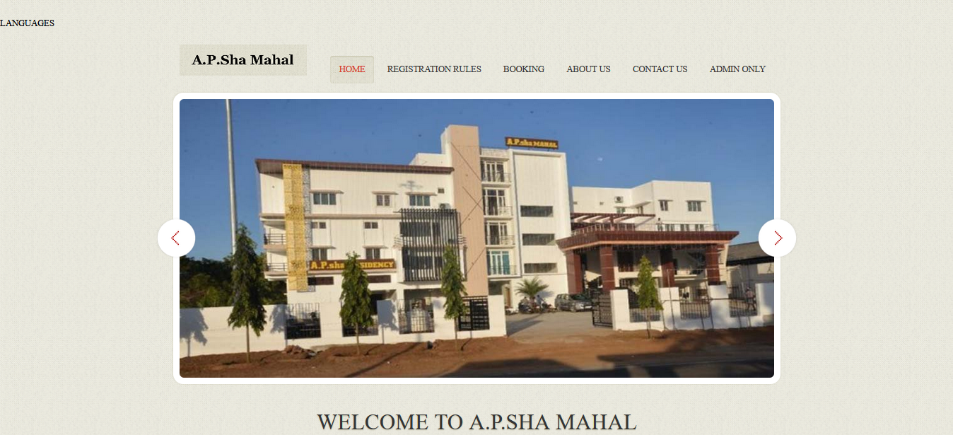

Slide 11
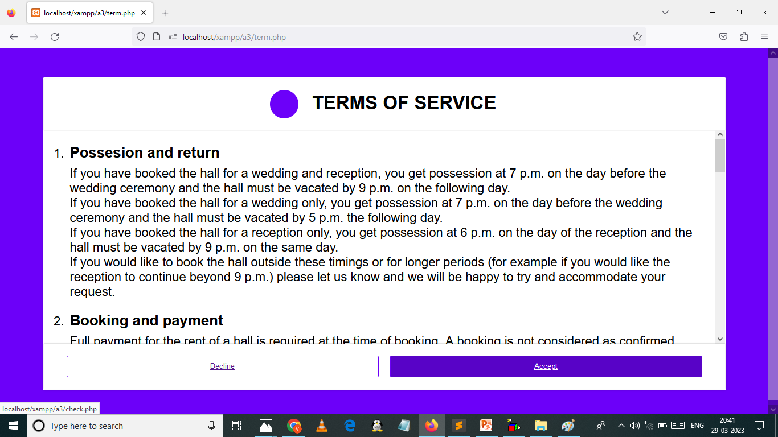

Slide 12
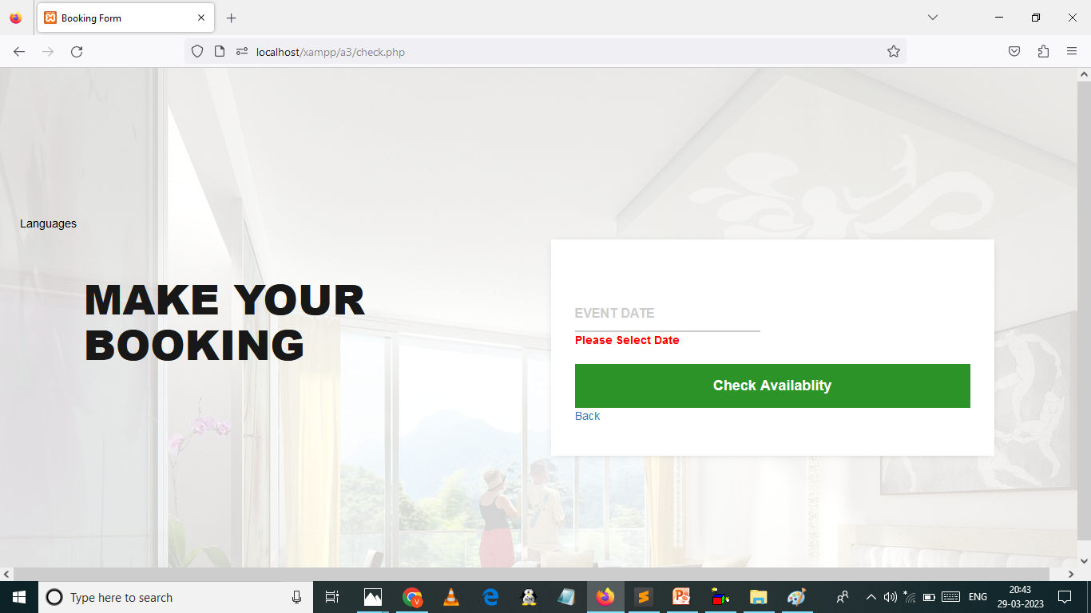
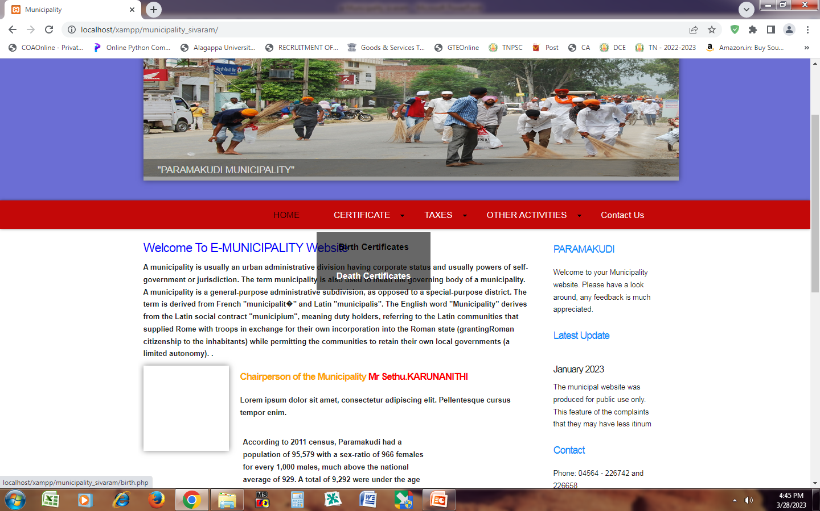

Slide 13
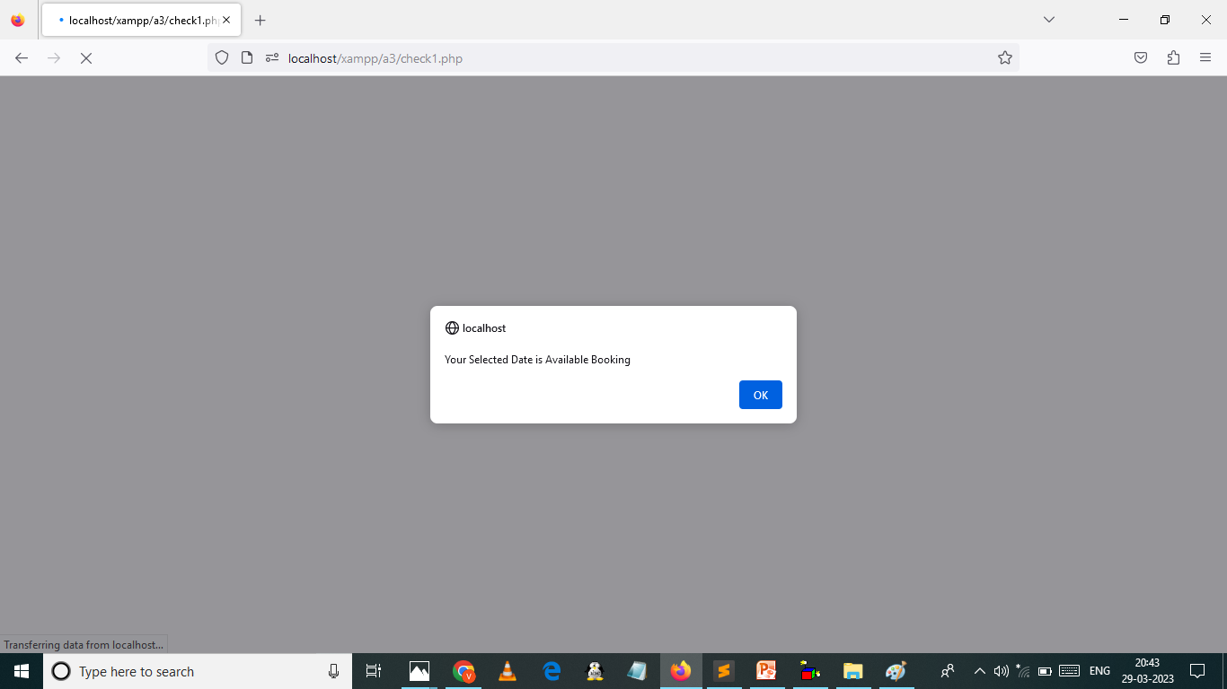
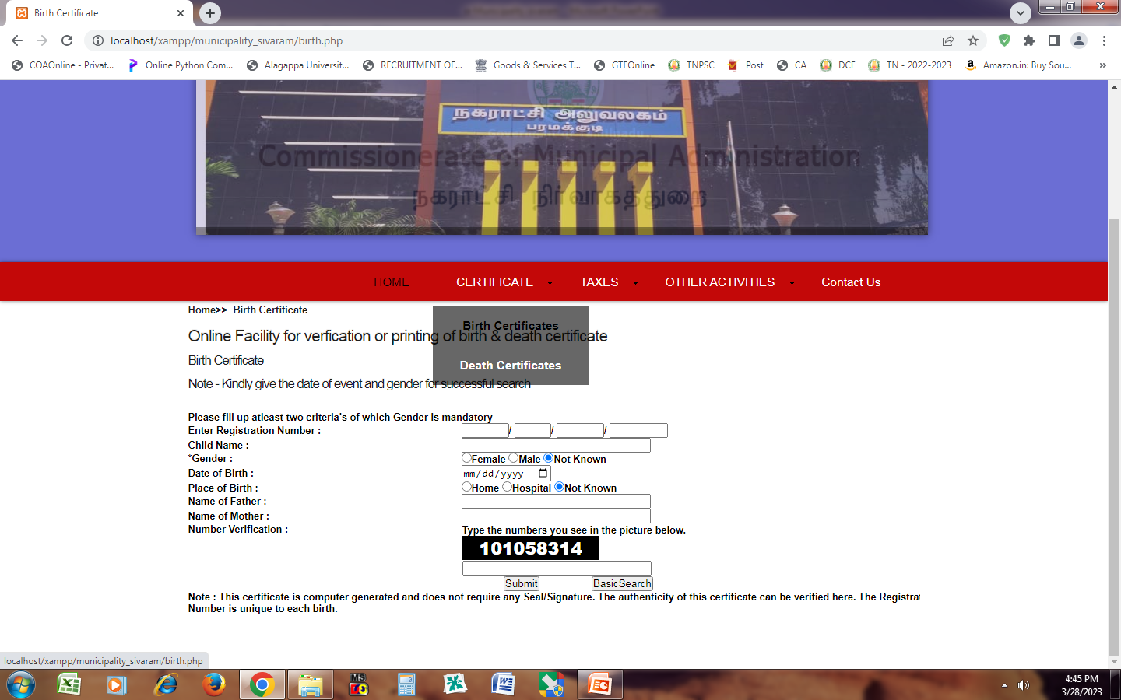

Slide 14
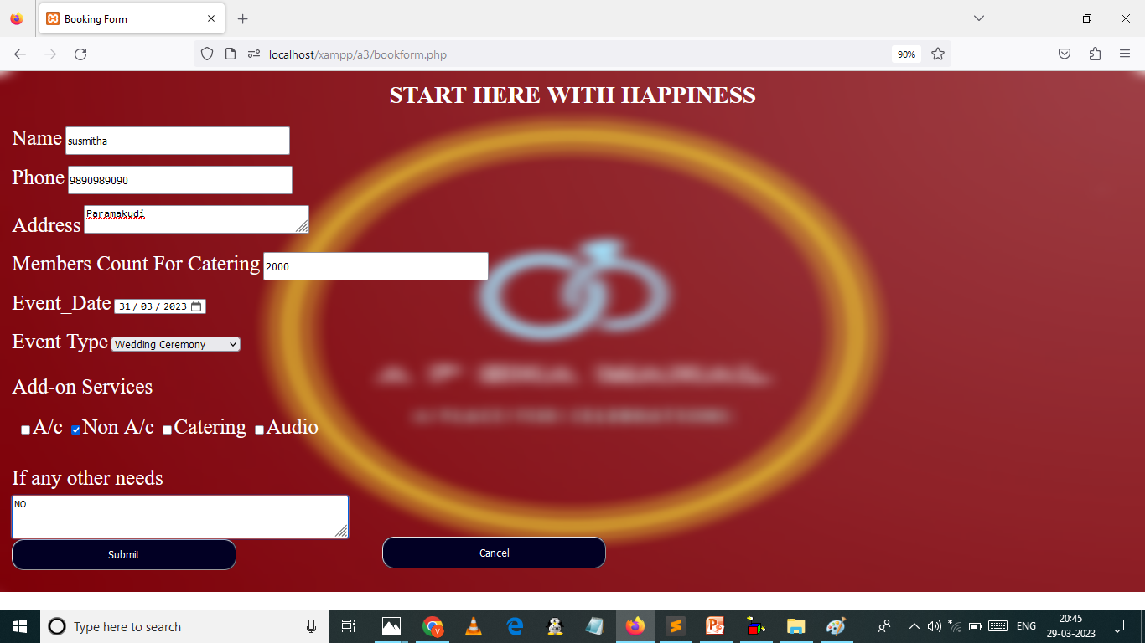
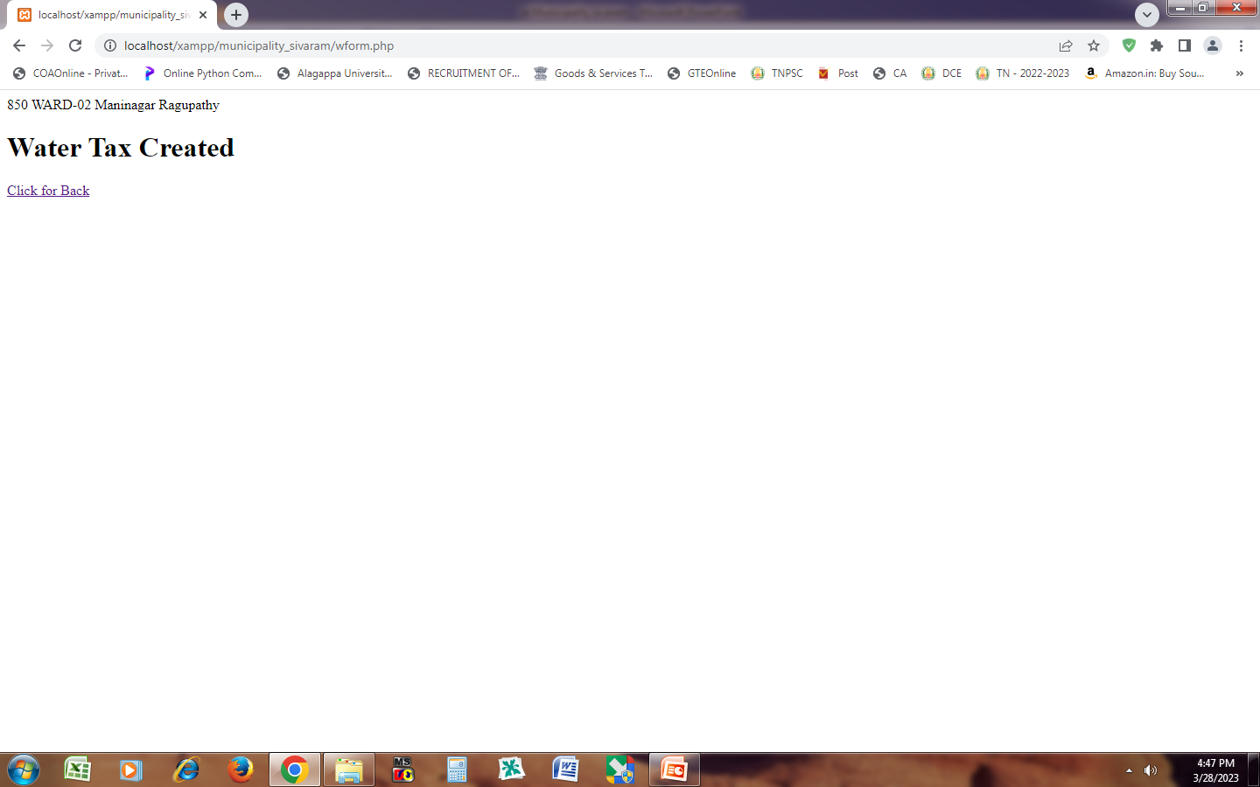

Slide 15
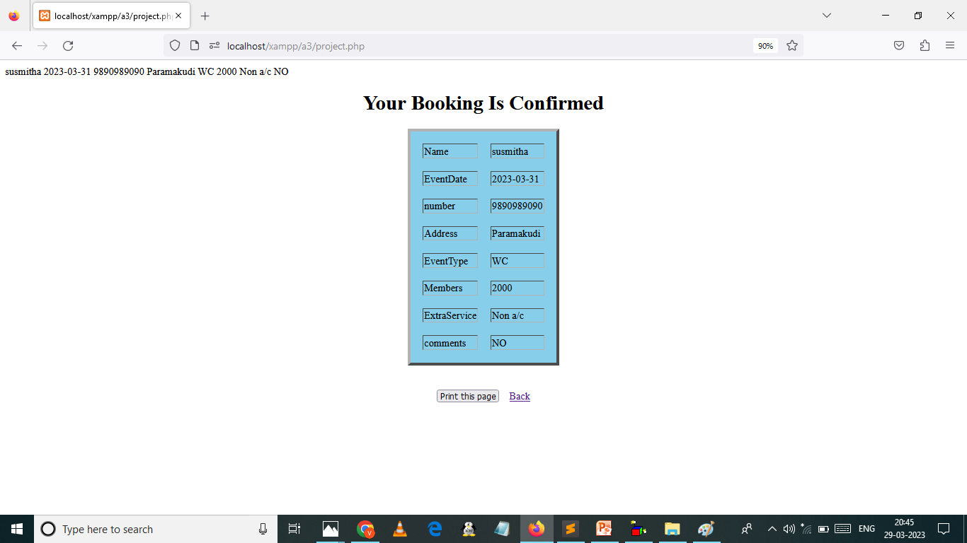
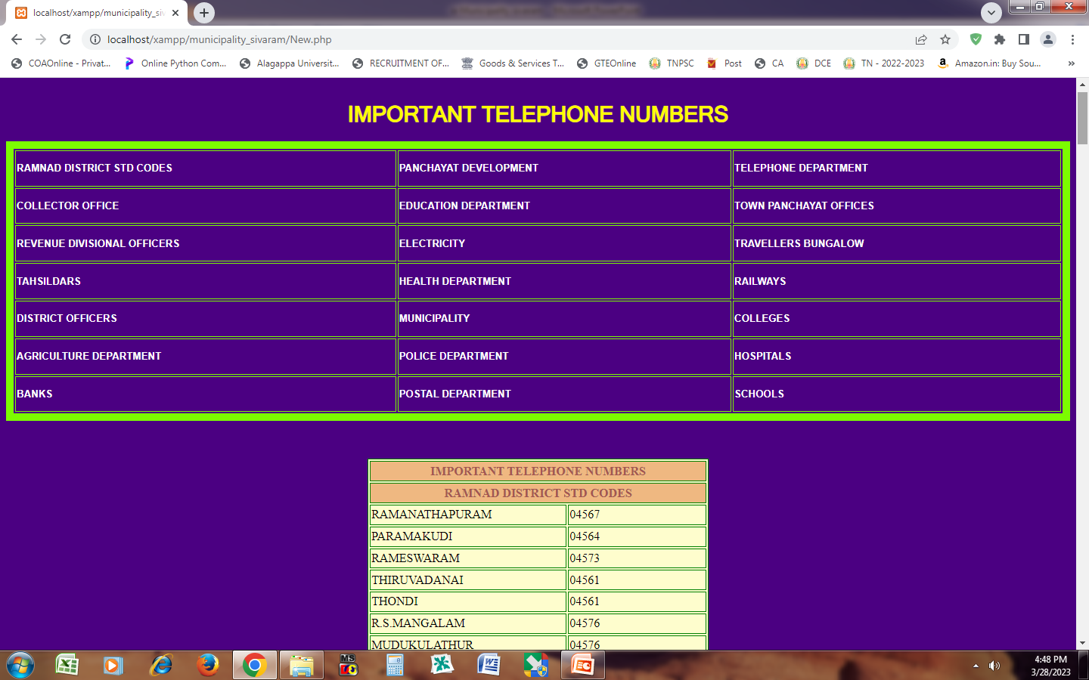

Slide 16
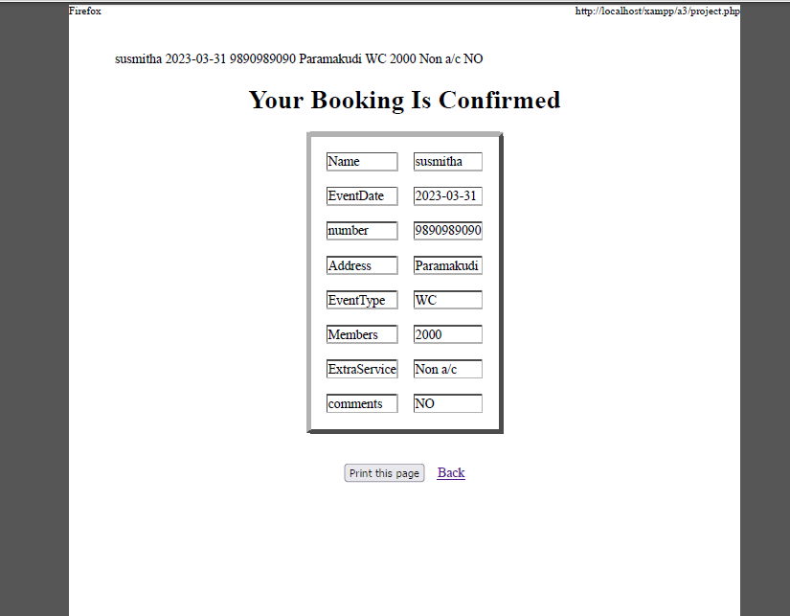

Slide 17
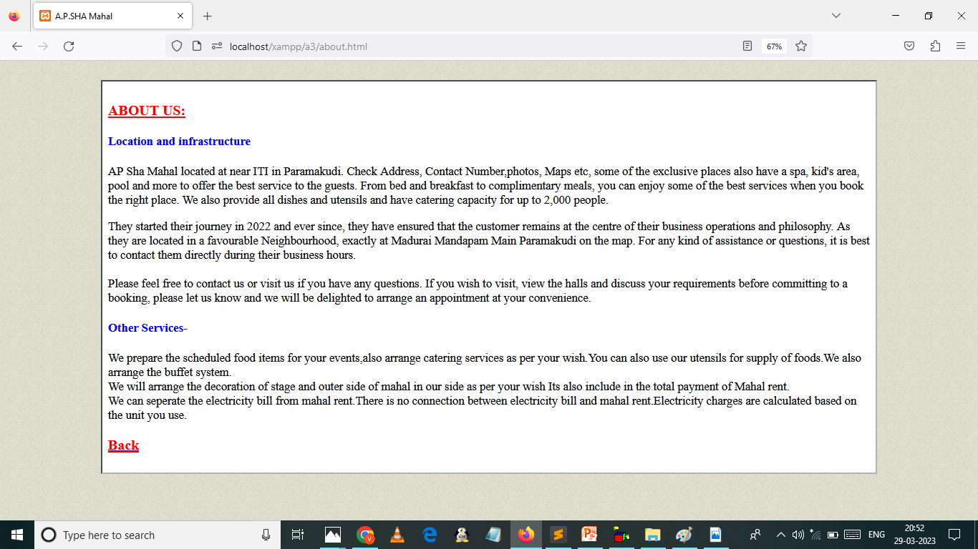

Slide 18
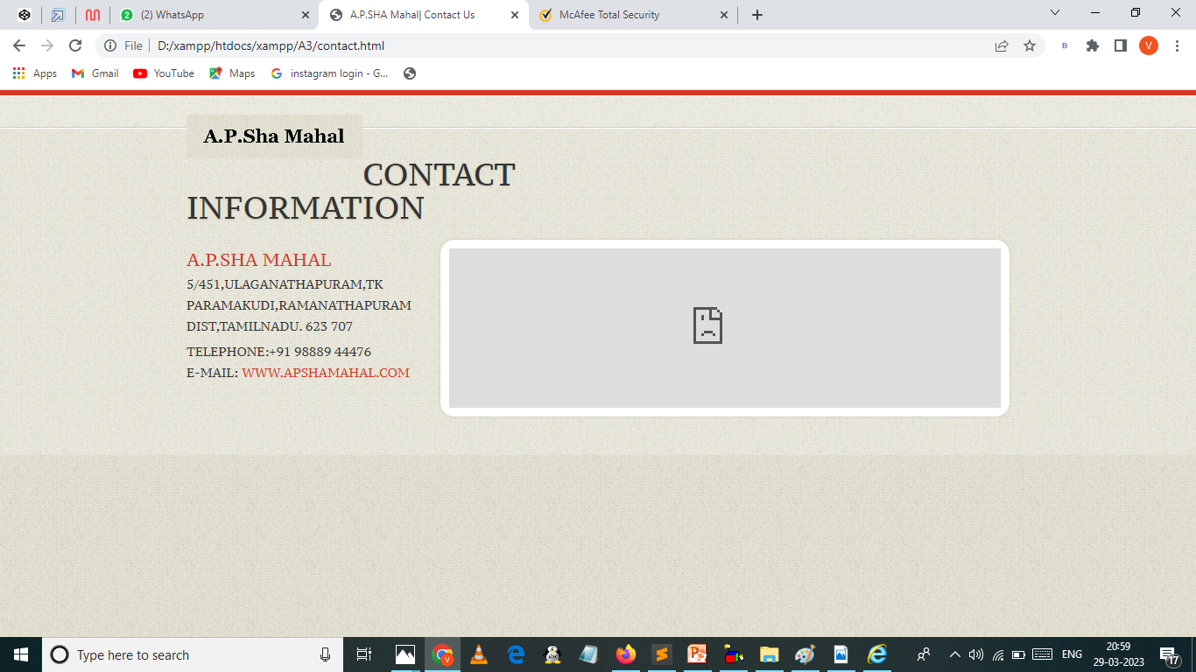

Slide 19
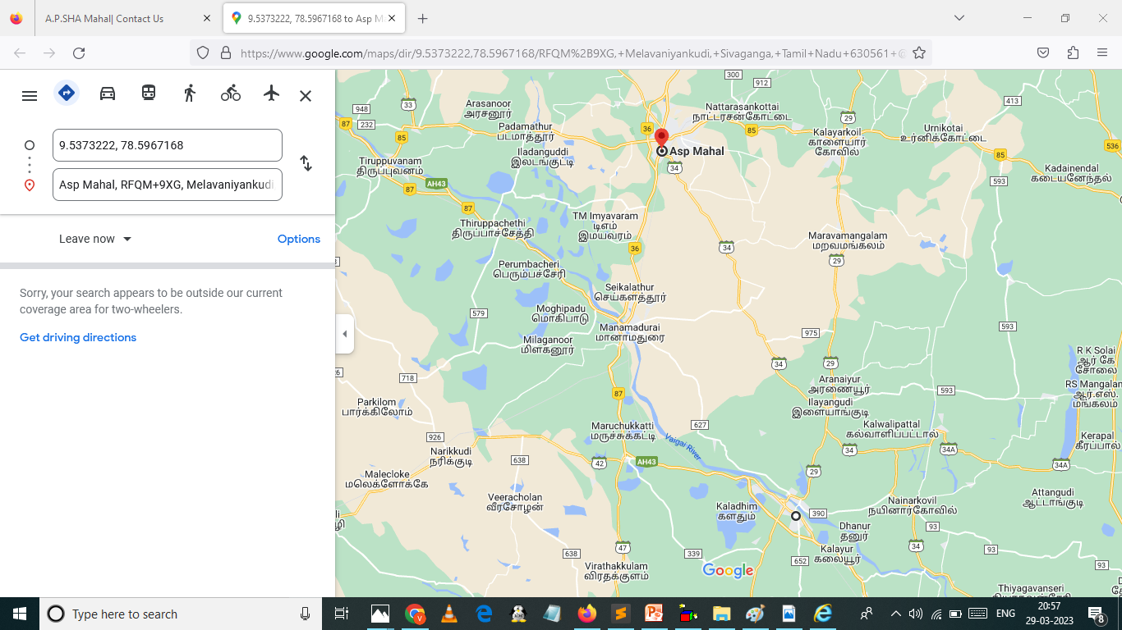

Slide 20
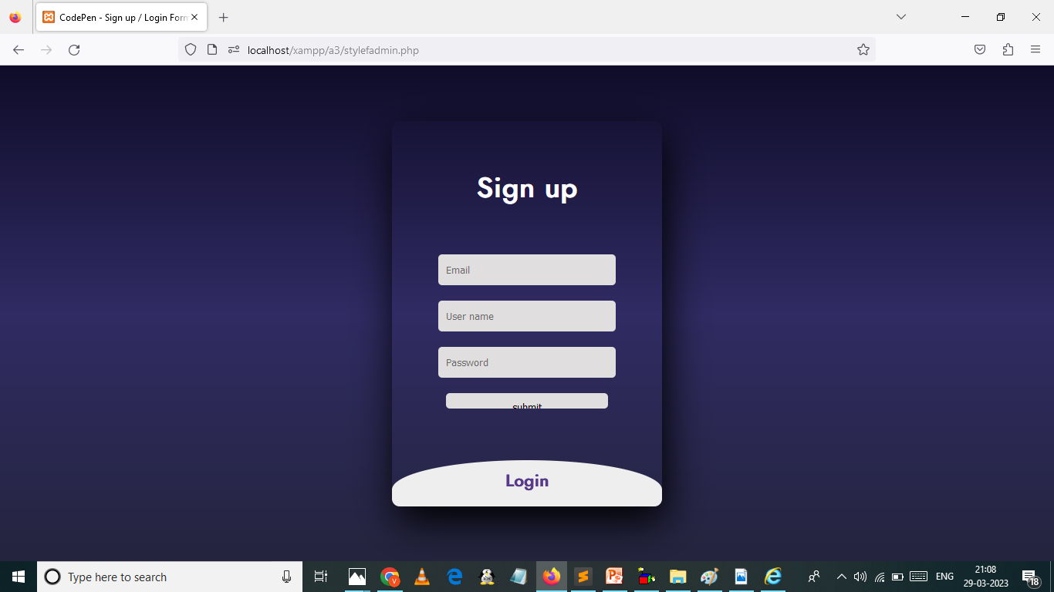

Slide 21
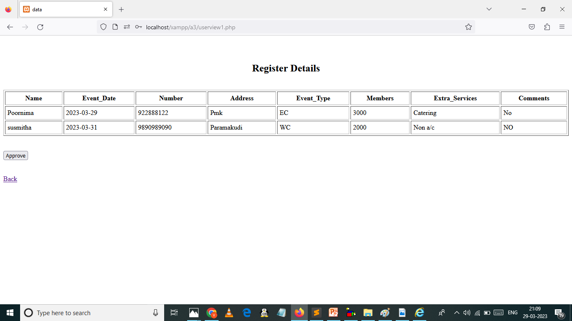

Slide 22


